Slide 1




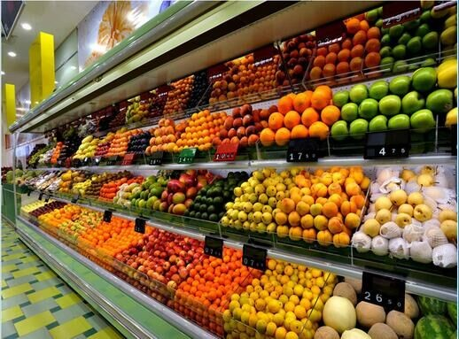
Assessing and Optimizing the Performance of
R-290 Integral Display Case

Slide 2



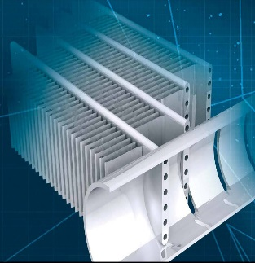

Contents
1
Introduction
2
Objectives
3
Current system Description
4
Analysis of Campaign 1 (200g)
5
Analysis of Campaign 2 (150g)
6
IMST-ART Simulations
7
Improvements and Suggestions
8
Inquiries
2

Slide 3
1
Introduction

Slide 4
The mission:
Assessing and optimizing the performance of the following R-290 integral display case.
The system comprises:
1 evaporator with 3 circuits of R290.
3 Copeland Scroll ZB09KAU-TFD compressors.
3 Danfoss D22-20 Micro-plate condensers.
4

Slide 5
Design point/working conditions:
Evaporation temperature: – 6 °C
Cooling capacity per compressor/circuit: 2.5 kW
Condensing temperature: 55 °C
Subcooling: 1 K
Superheat: 7 K to 10 K
Number of circuits: 3
Mass flow R-290 per circuit: 9.20 g/s
Tair,out: – 2 °C
Tair,in: 6 °C with 50% RH
5

Slide 6
2
Objectives

Slide 7
To analyze the experimental data of the current system.
To model the current system using IMST-ART simulation tool in order to assess the system performance.
To implement improvements to increase the performance while maintain the display case dimensions, such as: increasing the brine mass flow rate, reducing the number of condenser's plates, re-designing the evaporator’s circuits, etc.
7

Slide 8
3
Current system Description

Slide 9

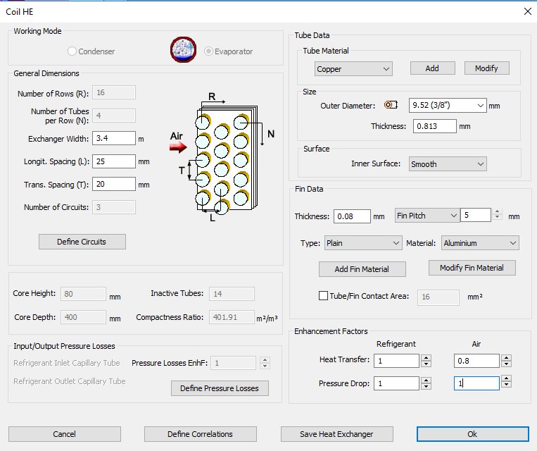
Evaporator
The current evaporator has the following dimensions:
9

Slide 10
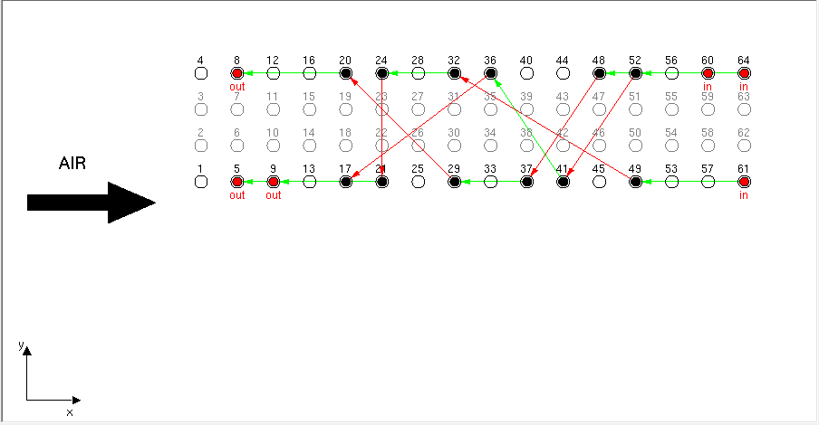
Evaporator
It has 3x 150g R290 circuits arranged as follows:
Inlet circuit 3 (C3)
Inlet circuit 2 (C2)
Inlet circuit 1 (C1)
Evap_Exp_V1 by IMST-ART
10

Slide 11
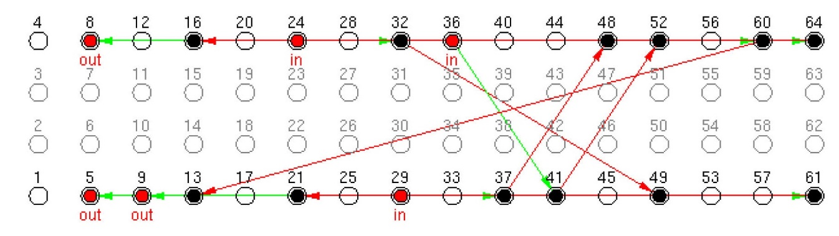
Evaporator
The new configuration is as follows:
Inlet circuit 1 (C1)
Inlet circuit 3 (C3)
Inlet circuit 2 (C2)
Evap_Exp_V2 by IMST-ART
11

Slide 12
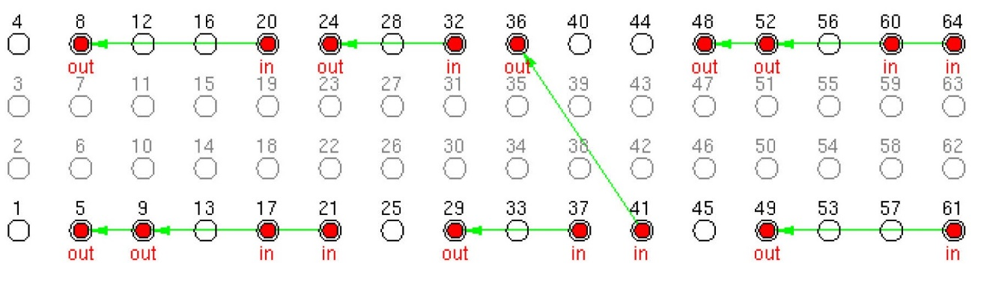
Evaporator
The 9-circuits configuration is as follows:
Evap_Num_9C by IMST-ART
12

Slide 13
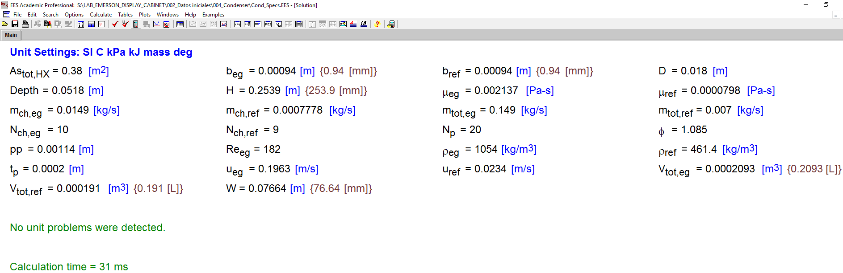
Condenser
To simulate the condenser in IMST-ART, it is required to specify the plate thickness and area enhancement factor.
With the aid of EES program and catalog data we have estimated correctly the plate thickness (2 mm) and area enhancement factor (1.085) which give quite similar effective surface area, Ethylene glycol velocity in the channel, total volume of refrigerant path, and total volume of Ethylene glycol path.
13

Slide 14
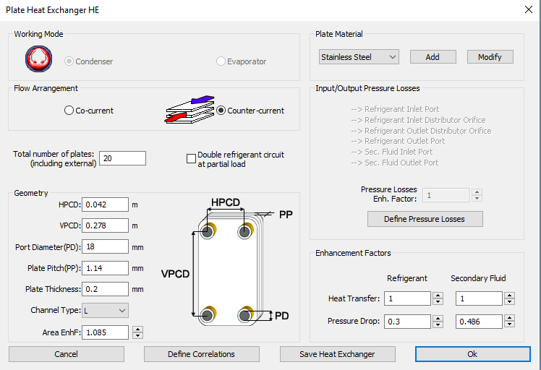
Condenser
Based on the previous analysis, The specifications of one condenser are introduced to IMST as follows:
14

Slide 15
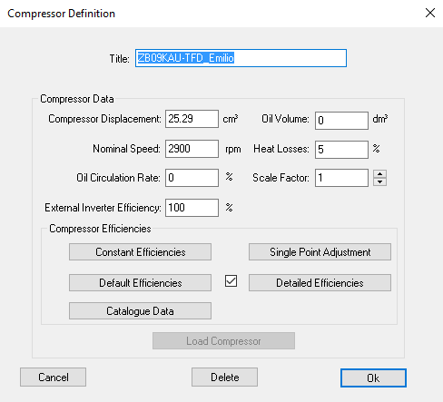
Compressor
The specifications of one compressor are:
We have assumed 0 oil volume. Because we have found that it is better to calculate the amount of refrigerant charge inside the compressor using the solubility curves.
15

Slide 16
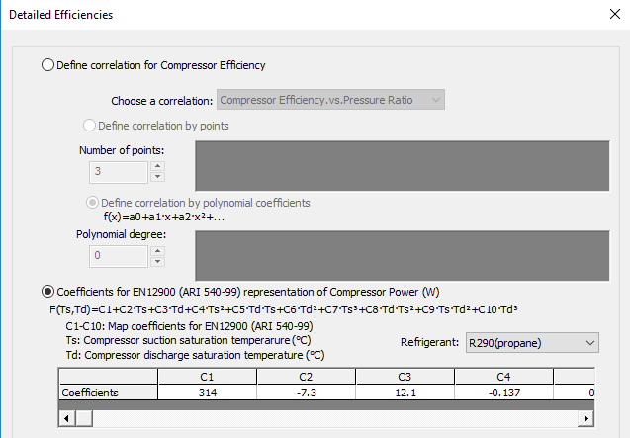
Compressor
The power correlation:
16

Slide 17
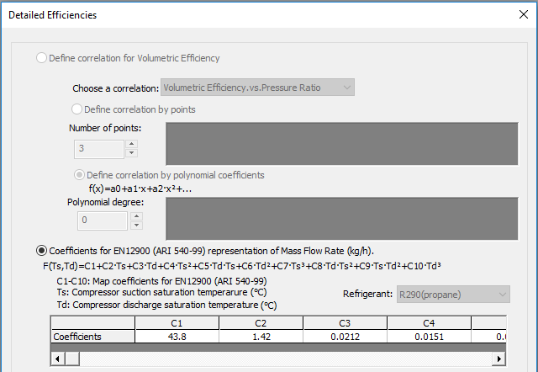
Compressor
The mass flow rate correlation:
17

Slide 18
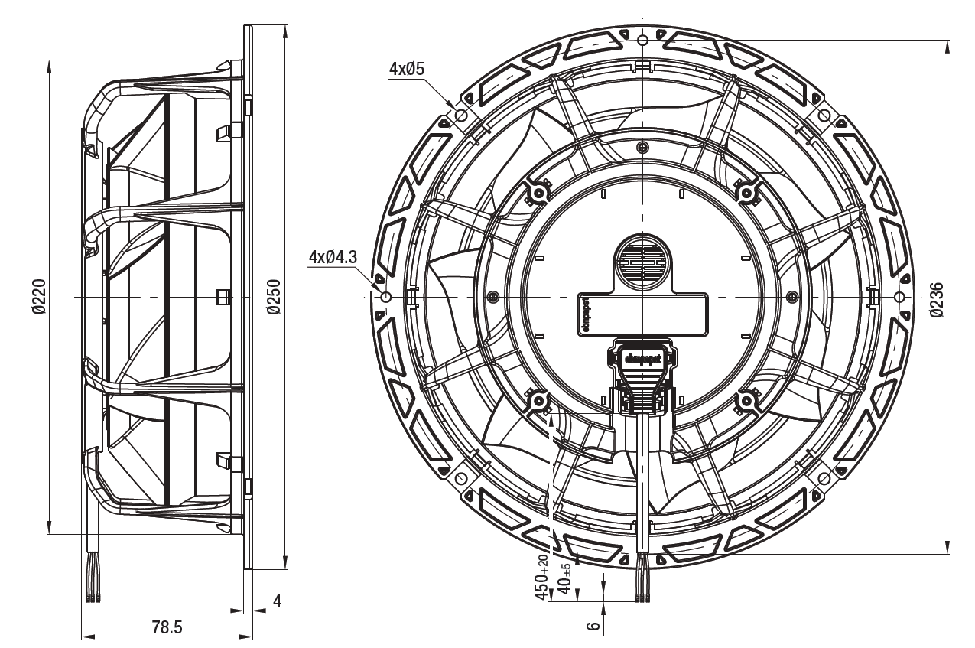
Evaporator Fans
The air flow is generated by 6 diagonal flow EC fans, model K1G-200 from EBM Papst running at 1400 rpm in the current arrangement.
The dimensions of one fan:
18

Slide 19
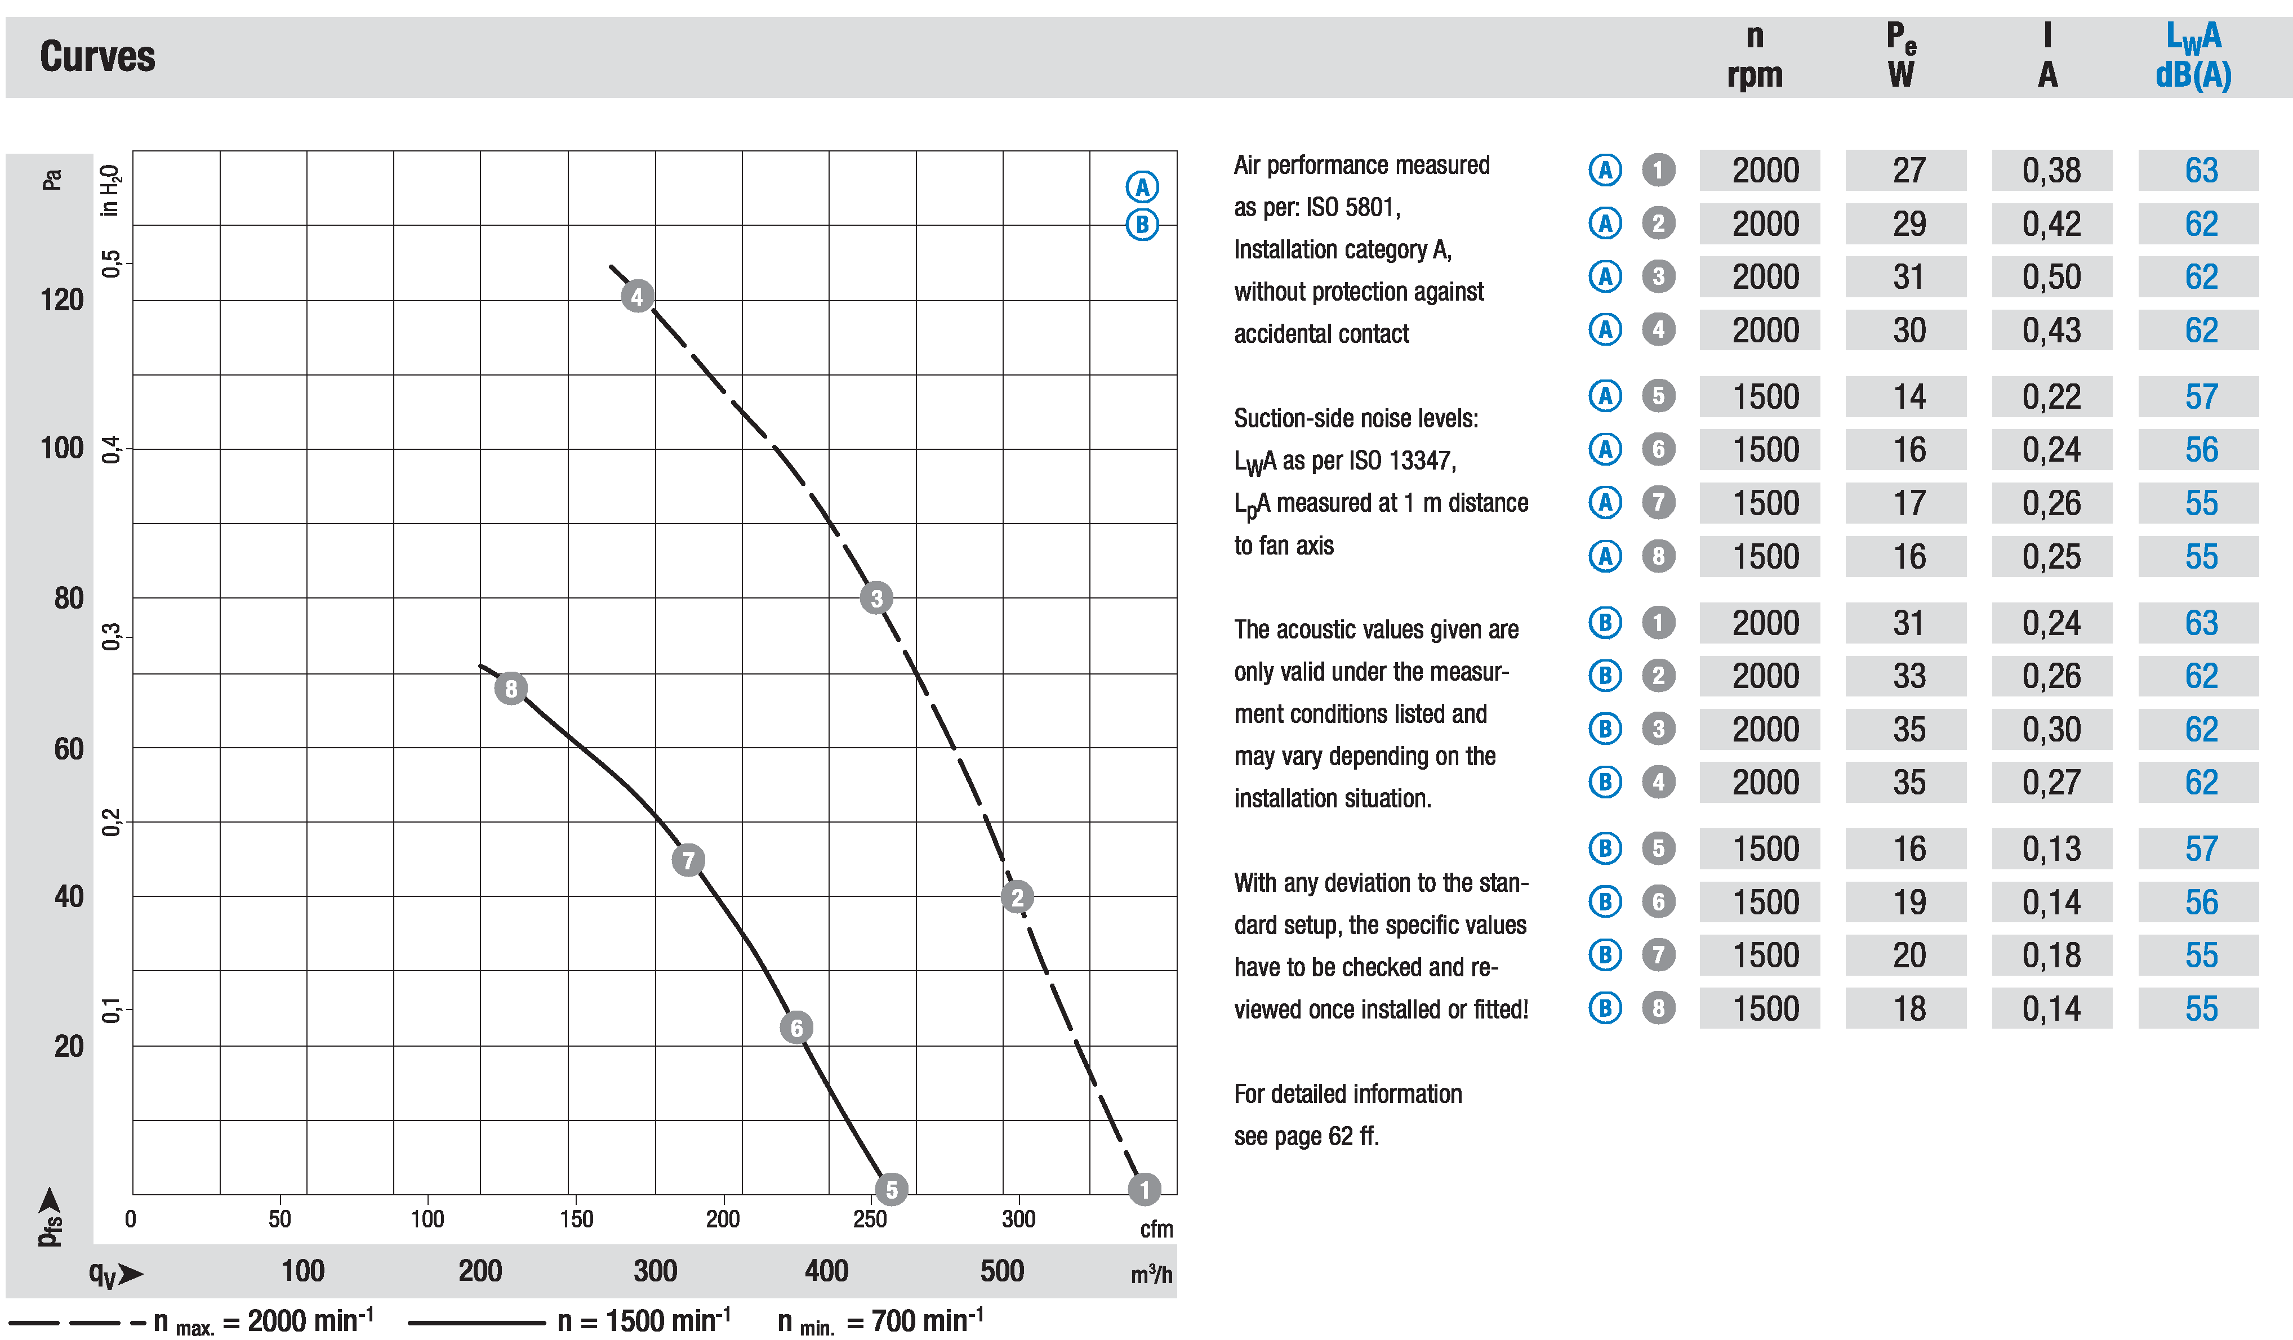
Evaporator Fans
The head vs flow rate curves are as follows:
19

Slide 20
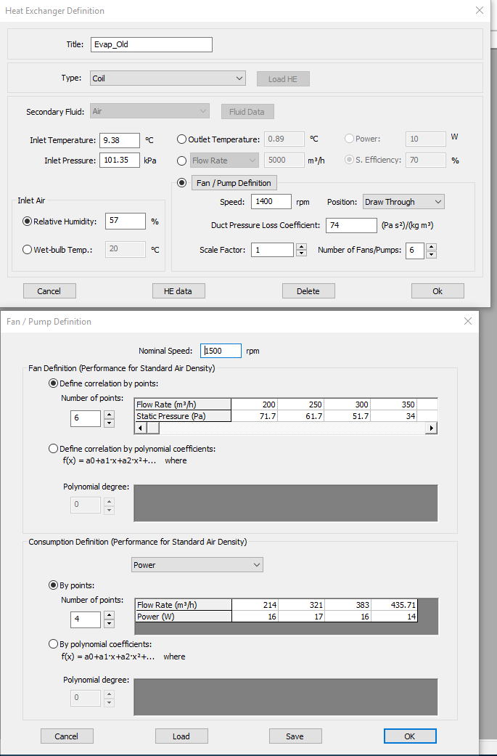
Evaporator Fans
The Fan curves are introduced to the IMST program as follows:
Static pressure VS flow rate curve
Fan power VS flow rate curve
20

Slide 21
4
Analysis of Campaign 1 (200 g)

Slide 22
Summary of Data Analysis
The high SC values (up to 12 K) indicate that C2 is overcharged.
Large fluctuations in SC and SH values for C2 (more than 10 K) can be observed from the previous figures.
The enthalpy analysis shows that C1 and C3 are undercharged.
These observations could indicate that the selected expansion valve is oversized.
22

Slide 23
Summary of Numerical Simulation
The numerical results show good agreement with the experimental data. IMST over-predicted the condensation temperature by 0.8 ºC, and under-predicted the evaporation temperature by 4.4 ºC. These deviations could be resulted from the large fluctuations in experimental data.
It can be clearly noticed that the outlet of condenser, based on the given data, is always inside the mixture zone. This could affect a lot the system performance.
The evaporator’s refrigerant-side and air-side pressure drops , 64 kPa and 38.2 Pa respectively, are not so large and are within the acceptable range.
23
Notes:
* We still need a comment on the charge

Slide 24
Summary of Improvements
Increasing the brine flow rate is a good improvement to the system, the results show that increasing the flow rate by 67% could results to an increase in the COP_aux by 5.3%; additionally, it results to a decrease in condensation temperature by 2.1 ºC.
Reducing the number of condenser plates to 16 plates results to a decrease in refrigerant charge by 7g; on the other hand, it has a negligible effect in condensation temperature (0.7 ºC increase in Tcond).
The new evaporator configuration (9-circuits) results to a notable decrease in refrigerant-side pressure drop by 94%, and to an increase in COP_aux by 6.7%.
applying a 5 K of SC is another way to improve the system performance. The results show that the presence of 5 K of SC results to an increase on refrigerant charge by 35 g. On the other hand, this results to an improvement in COP_aux by 4.6%.
24

Slide 25
5
Analysis of Campaign 2 (150 g)

Slide 26
Analysis of Test 5 (SH13, 1400RPM)
Test 5 was implemented by: Evap_Exp_V1, SH=13 K, and fan speed = 1400 RPM.
The SSR ranges between 16.7 hr to 17.3 hr.
We have chosen the results at 17 hr as the inputs to the IMST-ART.
The SSR data are summarized in the next figures.
The Tevap values for the three circuits are quite similar, with average of -8 C.
26

Slide 27
Analysis of Test 5 (SH13, 1400RPM)
C2 has a higher Tcond with 35 ºC.
C1 and C3 are more close with only 0.3 ºC difference in Tcond.
On the other hand, C1 and C3 have higher superheat with 15 K and 13.5 K respectively, while C2 has SH of 11.6 K.
27

Slide 28
Analysis of Test 18 (SH8, 1400RPM)
Test 18 was implemented by: Evap_Exp_V2, SH=8 K, and fan speed = 1400 RPM.
The SSR ranges between 69 hr to 69.5 hr.
We have chosen the results at 69.2 hr as the inputs to the IMST-ART.
The SSR data are summarized in the next figures.
The Tevap values for the three circuits are quite similar.
28

Slide 29
Analysis of Test 18 (SH8, 1400RPM)
C3 has a lower Tcond (34.3 ºC) compared to C1 (35 ºC) and C2 (35.4 ºC).
The SH values for the three circuits are quite similar, with an average value of 8.4 K.
The good control of SH values for the three circuits, results to similar Tevap for the three circuits.
29

Slide 30
Analysis of Test 19B (SH8, 1600RPM)
Test 19B was implemented by: Evap_Exp_V2, SH=8 K, and fan speed = 1600 RPM.
The SSR ranges between 40 hr to 40.5 hr.
We have chosen the results at 40.3 hr as the inputs to the IMST-ART.
The SSR data are summarized in the next figures.
C1 and C3 are very close with an average Tevap of -7.6 ºC.
C2 has a lower Tevap with an average value of -8 ºC.
30

Slide 31
Analysis of Test 19B (SH8, 1600RPM)
Maximum deviation in Tcond between the three circuits is 1.4 ºC.
The SH values for the three circuits are quite similar, with an average value of 8.4 K.
It can be seen, that SH values for C2 are slightly higher by 1 K compared to the other circuits. This, in turn, results to a lower Tevap for C2 compared to C1 and C3.
31

Slide 32
6
Imst-ART Simulations

Slide 33
Test 5 (Evap_Exp_V1, SH13, 1400RPM)
Comparison between Exp. and Num. Results for Test 5 (Evap_Exp_V1, SH13, 1400RPM)
Condenser |  |  |  |  |  | Refrigerant Charge (g)
Exp. |  |  | Num. | Diff. | Dev% | Evap. | 143
Qcond | kW | 8.8 | 8.08 | -0.72 | -8.5 | Cond. Channels | 30
h_ref_out | kJ/kg | 342.8 | 342.82 | 0.02 |  | Cond. Outlet Headers | 11.5
x_ref_out | - | 0.16 | 0.15 | 0.01 |  | Compressors | 49
Tcond | ºC | 34.2 | 36.5 | 2.3 |  | Liquid Line (3 circuits) | 25.3
T_ref_in | ºC | 70.4 | 71 | 0.6 |  | Total | 258.8
T_ref_out | ºC | 35 | 36.5 | 1.5
m_EG_total | kg/s | 0.51 | 0.47 | -0.04
Evaporator
Qevap | kW | 6.4 | 5.7 | -0.7 | -10
Tevap | ºC | -7.9 | -10.7 | -2.8
T_ref_in | ºC | -4 | -5 | -1
T_ref_out | ºC | 5.5 | 2.7 | -2.8
ΔP_ref | kPa | 54.8 | 68.8 | 14
T_air_out | ºC | 1.6 | 1.7 | 0.1
ΔP_air_tot | Pa | - | 64 | -
V_air | m³ /h | - | 1208 | -
COP | - | 2.5 | 2.3 | - | -8.3
33

Slide 34
Test 5 (Tcond = 55 C)
Comparison between Numerical Models for Test 5 (Evap_Exp_V1, SH13, 1400RPM)
Condenser |  |  |  |  |  | Refrigerant Charge (g)
Test 5 (Tcond= 36.5 C) |  |  | Test 5 (Tcond=55 C) | Diff. | Dev% | Evap. | 129
Qcond | kW | 8.08 | 8.6 | 0.52 | 7 | Cond. Channels | 43
h_ref_out | kJ/kg | 342.82 | 365.6 | 22.8 |  | Cond. Outlet Headers | 10.6
x_ref_out | - | 0.15 | 0.04 | - |  | Compressors | 40.5
Tcond | ºC | 36.5 | 55.4 | 18.9 |  | Liquid Line (3 circuits) | 23.4
T_ref_in | ºC | 71 | 100.2 | -29.2 |  | Total | 246.5
T_ref_out | ºC | 36.5 | 55.4 | 19
T_EG_in | ºC | 29.2 | 48.5 | 19.3
T_EG_out | ºC | 34.3 | 53.5 | 19.2
m_EG_total | kg/s | 0.47 | 0.5 | 0.03
Evaporator
Qevap | kW | 5.7 | 5.23 | -0.47 | -8.7
Tevap | ºC | -10.7 | -9.14 | 1.56
T_ref_in | ºC | -5 | -3.5 | 1.5
T_ref_out | ºC | 2.7 | 4.3 | 1.6
ΔP_ref | kPa | 68.8 | 69.9 | 1.1
T_air_out | ºC | 1.7 | 2.5 | 0.8
ΔP_air_tot | Pa | 64 | 65 | 1
V_air | m³ /h | 1208 | 1204 | -4
COP_Aux | - | 2.22 | 1.41 | - | -36%
34

Slide 35
Test 18 (Evap_Exp_V2, SH8, 1400RPM)
Comparison between Exp. and Num. Results for Test 18 (Evap_Exp_V2, SH8, 1400RPM)
Condenser |  |  |  |  |  | Refrigerant Charge (g)
Exp. |  |  | Num. | Diff. | Dev% | Evap. | 136
Qcond | kW | 8.4 | 7.9 | -0.5 | -6 | Cond. Channels | 31
h_ref_out | kJ/kg | 339.4 | 339.1 | -0.3 |  | Cond. Outlet Headers | 11.5
x_ref_out | - | 0.15 | 0.13 | - |  | Compressors | 52
Tcond | ºC | 35 | 37 | 2 |  | Liquid Line (3 circuits) | 25.3
T_ref_in | ºC | 68 | 68 | 0 |  | Total | 255.8
T_ref_out | ºC | 34 | 37 | 3
m_EG_total | kg/s | 0.52 | 0.47 | -0.05
Evaporator
Qevap | kW | 5.9 | 5.5 | -0.4 | -7
Tevap | ºC | -9.5 | -11.5 | -2
T_ref_in | ºC | -6 | -5.6 | 0.4
T_ref_out | ºC | -1.2 | -3.1 | -1.9
ΔP_ref | kPa | 52.8 | 70 | 17.2
T_air_out | ºC | -0.59 | -0.22 | 0.37
ΔP_air_tot | Pa | - | 65
V_air | m³ /h | - | 1206
COP | - | 2.3 | 2.2 | - | -2.8
35

Slide 36
Test 19B (Evap_Exp_V2, SH8, 1600RPM)
Comparison between Exp. and Num. Results for Test 19B (Evap_Exp_V2, SH8, 1600RPM)
Condenser |  |  |  |  |  | Refrigerant Charge (g)
Exp. |  |  | Num. | Diff. | Dev% | Evap. | 146
Qcond | kW | 8.96 | 8.6 | -0.36 | -4 | Cond. Channels | 32
h_ref_out | kJ/kg | 337.3 | 337.1 | -0.2 |  | Cond. Outlet Headers | 11.5
x_ref_out | - | 0.14 | 0.12 | - |  | Compressors | 57
Tcond | ºC | 34.6 | 37.5 | 2.9 |  | Liquid Line (3 circuits) | 25.3
T_ref_in | ºC | 66.3 | 65.3 | 1 |  | Total | 271.8
T_ref_out | ºC | 34.4 | 37.5 | 3.1
m_EG_total | kg/s | 0.54 | 0.51 | -0.03
Evaporator
Qevap | kW | 6.4 | 6.2 | -0.2 | -3.4
Tevap | ºC | -7.7 | -8.9 | -1.2
T_ref_in | ºC | -4 | -2.8 | 1.2
T_ref_out | ºC | 0.7 | -0.53 | -1.23
ΔP_ref | kPa | 58.3 | 77.5 | 19.2
T_air_out | ºC | 1.4 | 1.4 | 0
ΔP_air_tot | Pa | - | 74 | -
V_air | m³ /h | - | 1629.4 | -
COP | - | 2.4 | 2.5 | - | 2.4
36

Slide 37
Summary
IMST-ART has estimated the system performance with a reasonable accuracy.
The estimated Qcond and Qevap values are within an error band of ±10%.
IMST generally overestimates the Tcond up to 3 ºC.
IMST generally underestimates the Tevap up to 2.8 ºC.
Increasing the Tcond to 55 ºC, results to an increase in inlet and outlet temperatures of the EG up to 19 ºC. On the other hand, this results to a degradation in COP_aux up to 36%, compared with the original system.
37

Slide 38
7
Improvements and Suggestions

Slide 39
Test 5 (Evap_Exp_V1, SH13, 1400RPM)
Comparison between Test 5 (Np_cond=20, V_brine=1.6 m³/h) and Test 5 (Np_cond=16, V_brine=2.5 m³/h)
Condenser
Test 5 (Np=20, Vb=1.6 m3/h) |  |  | Test 5 (Np=16, Vb= 2.5 m3/h) | Diff. | Dev%
Qcond | kW | 8.08 | 8.1 | 0.02 | 0.25
Tcond | ºC | 36.5 | 35.4 | -1.1
h_Ref_out | kJ/kg | 342.82 | 333.3 | -9.52
T_EG_out | ºC | 34.3 | 32.5 | -1.8
m_EG_total | kg/s | 0.47 | 0.75 | 0.28 | 60
Evaporator
Qevap | kW | 5.7 | 6 | 0.3 | 5.3
Tevap | ºC | -10.7 | -11 | -0.3
T_air_out | ºC | 1.7 | 1.5 | -0.2
COP_Aux | - | 2.22 | 2.32 | - | 4.5
39

Slide 40
Test 18 (Evap_Exp_V2, SH8, 1400RPM)
Comparison between Test 18 (Np_cond=20, V_brine=1.6 m³/h) and Test 18 (Np_cond=16, V_brine=2.5 m³/h)
Condenser
Test 18 (Np=20, Vb=1.6 m3/h) |  |  | Test 18 (Np=16, Vb= 2.5 m3/h) | Diff. | Dev%
Qcond | kW | 7.9 | 8 | 0.1 | 1.3
Tcond | ºC | 37 | 36 | -1
h_Ref_out | kJ/kg | 339.1 | 328 | -11
T_EG_out | ºC | 35 | 33 | -2
m_EG_total | kg/s | 0.47 | 0.74 | 0.27 | 57
Evaporator
Qevap | kW | 5.5 | 5.7 | 0.2 | 3.6
Tevap | ºC | -11.5 | -12 | -0.5
T_air_out | ºC | -0.22 | -0.5 | -0.3
COP_Aux | - | 2.1 | 2.22 | - | 5.7
40

Slide 41
Test 19B (Evap_Exp_V2, SH8, 1600RPM)
Comparison between Test 19B (Np_cond=20, V_brine=1.7 m³/h) and Test 19B (Np_cond=16, V_brine=2.5 m³/h)
Condenser
Test 19B (Np=20, Vb=1.7 m3/h) |  |  | Test 19B (Np=16, Vb= 2.5 m3/h) | Diff. | Dev%
Qcond | kW | 8.6 | 8.7 | 0.1 | 1.16
Tcond | ºC | 37.5 | 36.7 | -0.8
h_Ref_out | kJ/kg | 337.1 | 327 | -10.1
T_EG_out | ºC | 35 | 33.5 | -1.5
m_EG_total | kg/s | 0.51 | 0.74 | 0.23 | 45
Evaporator
Qevap | kW | 6.2 | 6.4 | 0.2 | 3.23
Tevap | ºC | -8.9 | -9.3 | -0.4
T_air_out | ºC | 1.4 | 1.15 | -0.25
COP_Aux | - | 2.4 | 2.54 | - | 5.83
41

Slide 42
Summary
Decreasing the condenser plates to 16 plates, combined with increasing the flow rate of the brine to 2.5 m³/h result to the following, compared to the original tests:
To an increase in Qcond up to 1.3 %.
To a decrease in Tcond up to 1 ºC.
To an increase in Qevap up to 5.3%.
To a decrease in Tevap up to 0.5 ºC.
To an increase in Cop_aux up to 5.8%.
We will implement further parametric studies, regarding the plates number and brine’s flow rate, in order to optimize the system performance.
42

Slide 43
Further Suggestions
Using water as secondary fluid in the condensers instead of Ethylene Glycol.
New configurations for the evaporator (more tubes in rows, staggered arrangement, etc.)
43

Slide 44
8
Inquiries

Slide 45
To obtain an accurate evaluation of the system, we need some further information.
Our main inquires are listed below:
We need to check again the test data in Test 22 and 23.
More information about the system components, to estimate correctly the total refrigerant charge.
45

Slide 46
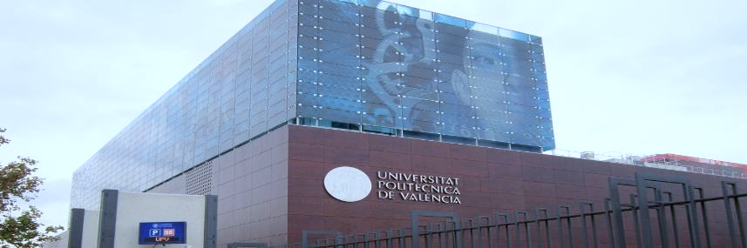


Thanks for Your Attention
Notes:
* And I´m I looking forward for your questions and inquiries.

